Slide 1
The Dragon of Pharos
- a graphics project

Slide 2
Computer graphics
Powerful tool for rapid and economical production of pictures
Applications are in almost every field from Computer aided design to entertainments.

Slide 3
Introduction
A dragon, a lighthouse and the environment
3D graphics model of above
Color filling and lightning effects
Programmed in C++
SDL for input handling
OpenGL to plot points

Slide 4
General features
Dragon and Pharos Objects
Created using different methods
Vertices loading for complex objects like dragon
Manual plotting of other objects like pharos and ground
Ability to work with individual objects

Slide 5
Why SDL and OPENGL?
SDL
Ease of Operation
Previous Experience
OpenGL
Better performance than SDL for plotting points

Slide 6
Algorithms used
Bresenham’s line drawing algorithm
Scan line algorithm for filling
Visible surface detection-Z buffer method
Phong shading
Phong Illumination

Slide 7
Bresenham’s line drawing algorithm
Better approximation to form a straight line
Uses only integer calculation

Slide 8
Scan line algorithm for filling
Walk along edges one scan-line at a time

Slide 9
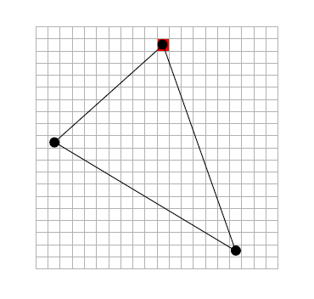

Slide 10
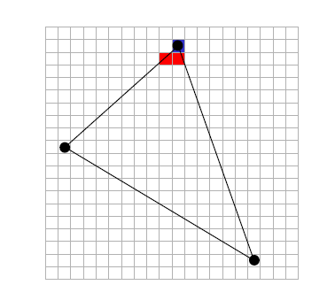

Slide 11
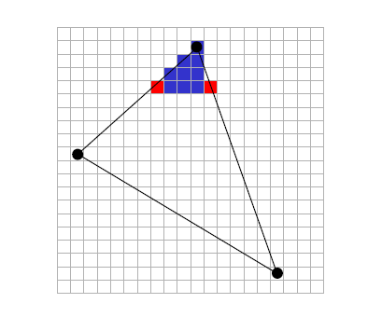

Slide 12
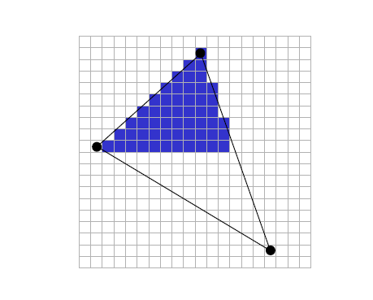

Slide 13
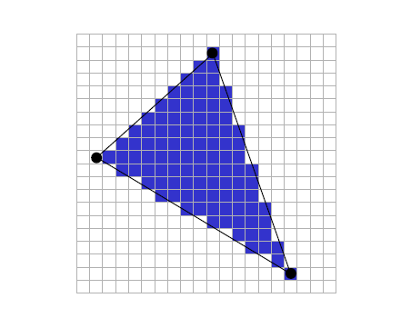

Slide 14
Z buffer method
Managing of image depth coordinates in three-dimensional graphics.
When an object is rendered the depth of a generated pixel (z-coordinate) is stored in a buffer (the z buffer or depth buffer).
If another object of the scene must be rendered in the same pixel, the method compares the two depths and overrides the current pixel if the object is closer to the observer.
The chosen depth is then saved to the z-buffer, replacing the old one. in the end the z buffer will allow the method to correctly reproduce the usual depth perception; a close object hides the farther one.

Slide 15
Phong shading and Illumination
Produce a certain degree of realism in three-dimensional objects
Combines three elements-diffuse, specular and ambient light for each considered point on a surface.
Assumptions-all light are points, specular color is the same as light color and ambient is a global constant.

Slide 16
Objects Created
Cube
Prism
Hemisphere
Torus
Truncated Cone
Dragon

Slide 17
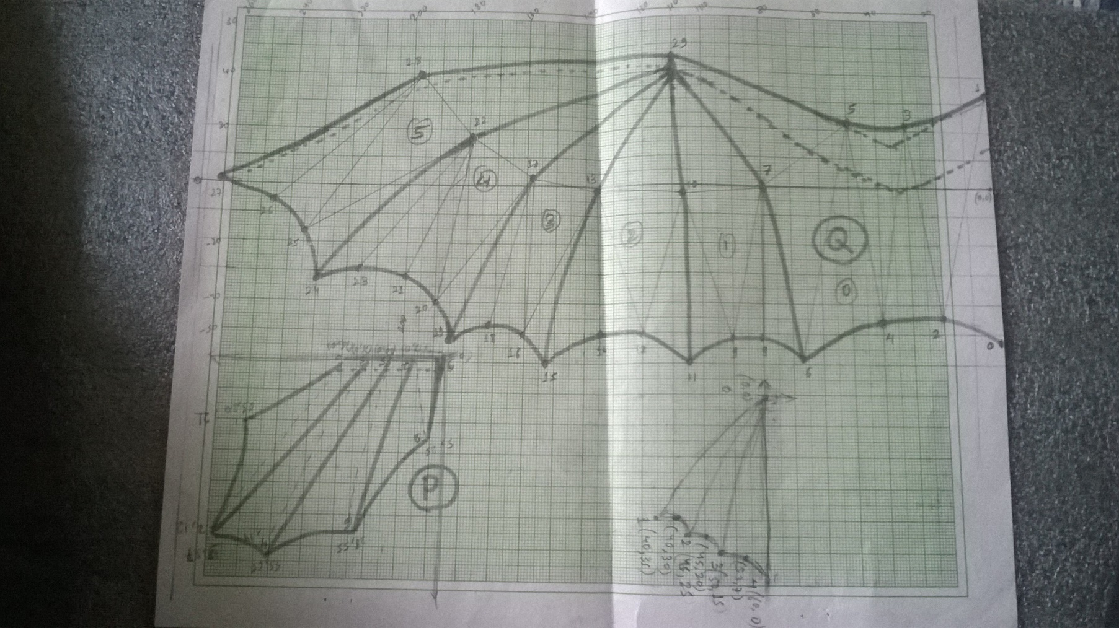
Vertices defining

Slide 18
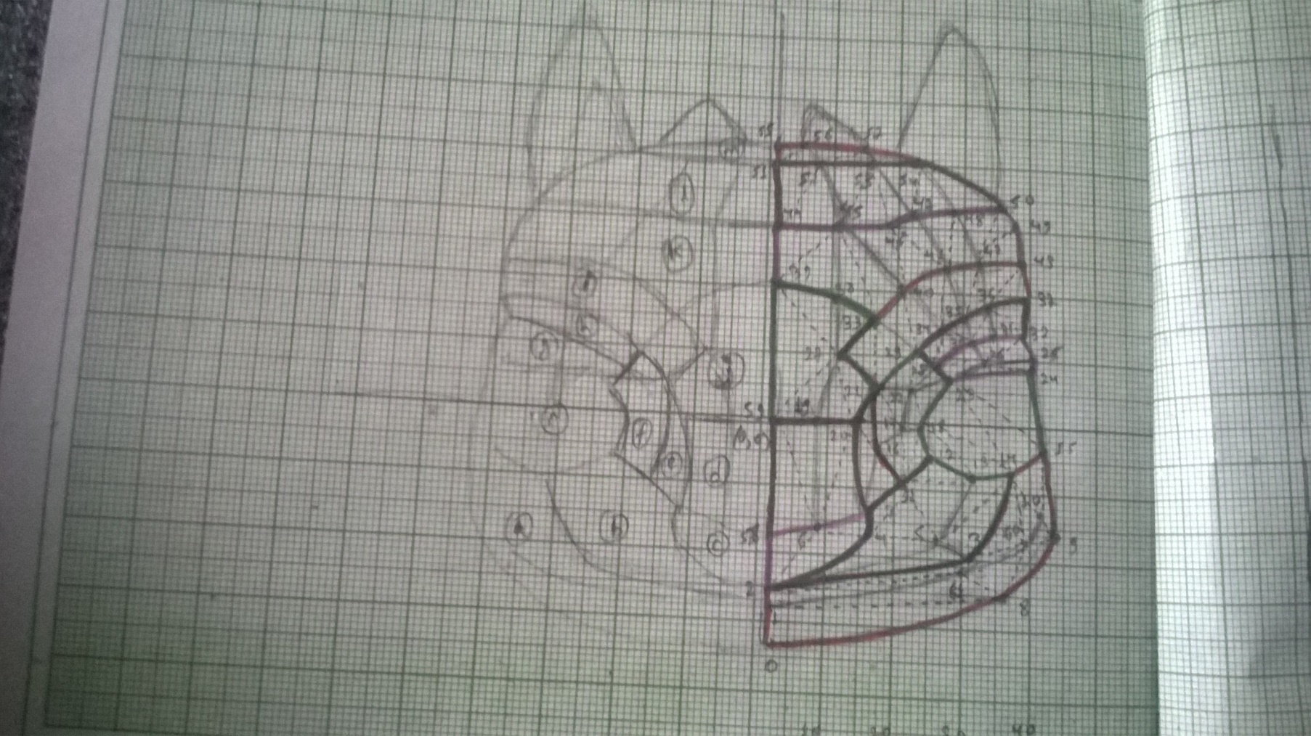

Slide 19
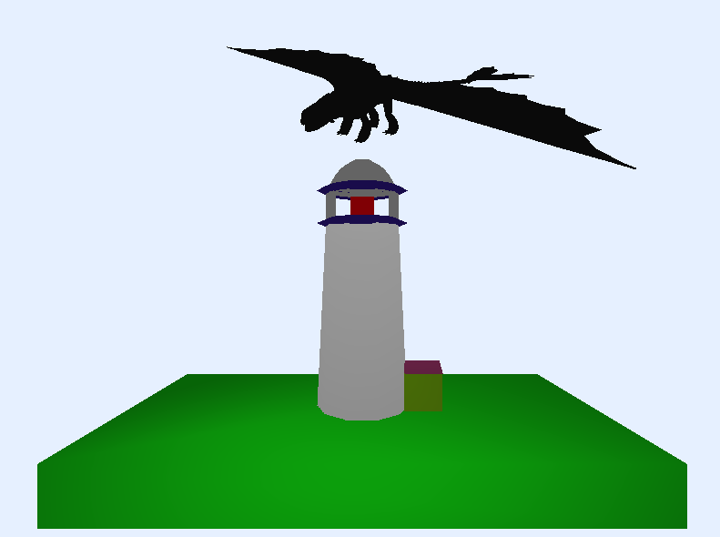
Result

Slide 20
Limitations:
Excessive CPU load
Slow rendering
No proper lighting effects
No Shadows

Slide 21
References:
C-Man (Previous C++ Project)
http://www.sitepoint.com/series/write-a-3d-soft-engine-from-scratch/
SDL Development programming

Slide 22
Thank you!!!!

